Slide 1
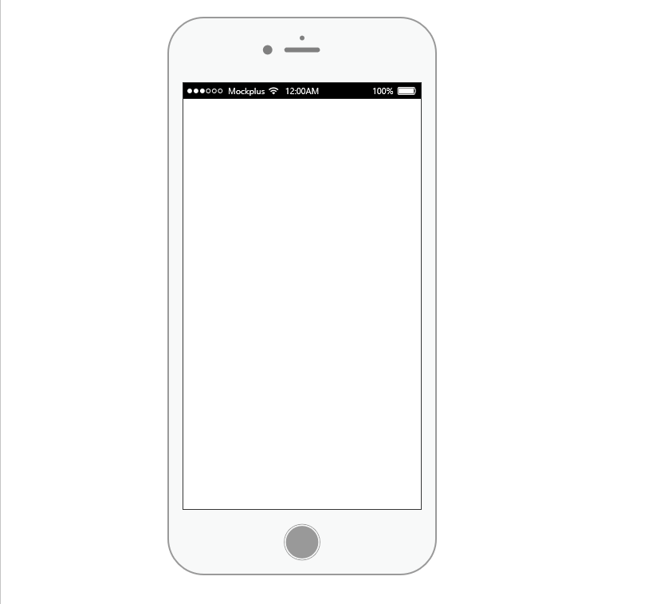

Registration
Name:
Address:
DOB:
Location:
Email ID:
Password:
Confirm Password:
Already Have an Account?
Login Here
Login
Email ID:
Password
Login
Register
Notes:
Register With the Required Credentials or Login If u Already have an Account.

Slide 2
FIRST AID:
------------------------------------------------------------------------------------------------------------------------------------------------------------------------------------------------------------------------------------------------------------------------------------------------------------
First-Aid
Emergency
Live Doctor Call
Notes:
Claasify Your issue as a First Aid,Critical Emergency or You want to talk to your Doctor.Basic Advice In first Aid

Slide 3
Emergency:
Ambulance:100
Nearest Hospital Near You(GPS):
Tips:
----------------------------------------------------------------------------------------------------------------------------------------------------
Live Doctor Call:
Appointment Time:
Doctor:
Issue:
Call Or Chat
Notes:
Ambulance Number,Nearest Hospital and Tips in Emergency.Book an Appointemnt with the doctor at Live Doctor Call

